Slide 1
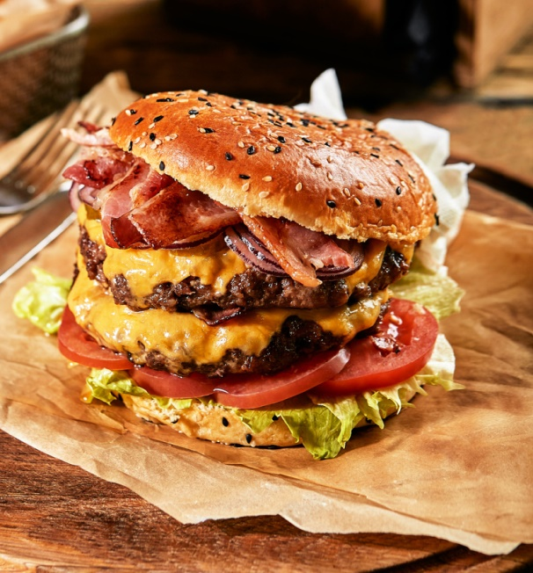
FASTING

Slide 2
Why Fast?
To draw closer to the Lord
To seek His will
To humble ourselves
To return to the Lord
To repent
To grow spiritually
To grow in discipline

Slide 3
Jesus
Moses
Ezra
Ninevah
Esther
Paul & Barnabas
Daniel
Anna
David
Etc, etc, etc

Slide 4
^{Daniel 10:12-14}
¹² Then he said to me, “Do not fear, Daniel, for from the first day that you set your heart to understand, and to humble yourself before your God, your words were heard; and I have come because of your words. ¹³ But the prince of the kingdom of Persia withstood me twenty-one days; and behold, Michael, one of the chief princes, came to help me, for I had been left alone there with the kings of Persia. ¹⁴ Now I have come to make you understand what will happen to your people in the latter days, for the vision refers to many days yet to come.”

Slide 5
^{Joel 2:12-13}
¹² “Even now”, declares the Lord, “return to Me with all your heart, with fasting and weeping and mourning.” Rend your heart and not your garments. Return to the Lord your God, for he is gracious and compassionate, slow to anger and abounding in love, and he relents from sending calamity.

Slide 6
^{Matthew 17:20-21}
²⁰ So Jesus said to them, “Because of your unbelief; for assuredly, I say to you, if you have faith as a mustard seed, you will say to this mountain, ‘Move from here to there,’ and it will move; and nothing will be impossible for you. ²¹ However, this kind does not go out except by prayer and fasting.”

Slide 7
^{Matthew 6:16-18}
¹⁶ “Moreover, when you fast, do not be like the hypocrites, with a sad countenance. For they disfigure their faces that they may appear to men to be fasting. Assuredly, I say to you, they have their reward. ¹⁷ But you, when you fast, anoint your head and wash your face, ¹⁸ so that you do not appear to men to be fasting, but to your Father who is in the secret place; and your Father who sees in secret will reward you openly.

